Slide 1


Encapsulation and Inheritance
variables
SoftUni Team
Technical Trainers
Software University
https://softuni.bg

Slide 2
Have a Question?
sli.do
#prgm-for-qa

Slide 3
Table of Contents
OOP Principles
Encapsulation
Access Modifiers
State Validation
Inheritance
Accessing Base Class Members

Slide 4
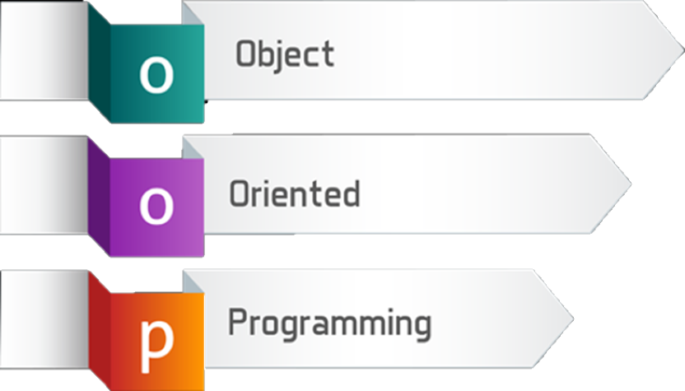
OOP Principles
Encapsulation, Inheritance, Abstraction, Polymorphism

Slide 5
The Principles of OOP
Classical principles of the object-oriented programming (OOP):
Encapsulation: objects keep its state private (no direct access)
Inheritance: child classes inherit data + functionality from a parent
Abstraction: hide complexity behind an interface or abstract class
Polymorphism: use subclass objects through their base class

Slide 6

Encapsulation
Hiding Implementation

Slide 7
Encapsulation
Process of wrapping code and data together into a single unit
Flexibility and extensibility of the code
Reduces complexity
Structural changes remain local
Allows validation and data binding
7
Notes:
Encapsulation hides the implementation details
Class announces only a few operations (methods) available for its clients - its public interface
All data members (fields) of a class should be hidden
Accessed via properties (read-only and read-write)
No interface members should be hidden
Encapsulation == hide (encapsulate) data behind constructors and properties

Slide 8
Encapsulation – Example
Fields should be private
Properties should be public
Person
-name: string
-age: int
- == private
+Person(string name, int age)
+Name: string
+Age: int
+ == public
8
Notes:
Fields are private
Constructors and accessors are defined (getters and setters)

Slide 9
Keyword This
Reference to the current object
Refers to the current instance of the class
Can be passed as a parameter to other methods
Can be returned from method
Can invoke current class methods
9
Notes:
Constructors are declared public
Constructors perform checks to keep the object state valid
Interface methods are always public
Not explicitly declared with public
Non-interface methods are declared private / protected

Slide 10

Visibility of Class Members
Access Modifiers

Slide 11
Private Access Modifier
It's the main way to perform encapsulation and hide data from the outside world
The default field and method modifier is private
private string name;
Person (string name) {
this.name = name;
}
11
Notes:
Access Level "public"
When we use the modifier public in front of some element, we are telling the compiler, that this element can be accessed from every class, no matter from the current project (assembly), from the current package. The access level public defines the miss of restrictions regarding the visibility. This access level is the least restricted access level in Java.
Access Level "private"
The access level private is the one, which defines the most restrictive level of visibility of the class and its elements. The modifier private is used to indicate, that the element, to which is issued, cannot be accessed from any other class (except the class, in which it is defined), even if this class exists in the same package.
Access Level “protected"
The access level private is the one, which defines the most restrictive level of visibility of the class and its elements. The modifier private is used to indicate, that the element, to which is issued, cannot be accessed from any other class (except the class, in which it is defined), even if this class exists in the same namespace.
Access Level “default"
This is the default access level, i.e. it is used when there is no access level modifier in front of the respective element of a class. Members can be accessed only from the same package.

Slide 12
Public Access Modifier
The most permissive access level
There are no restrictions on accessing public members
To access class directly from a namespace use the using keyword to include the namespace
public class Person {
public string Name { get; set; }
public int Age { get; set; }
}
12
Notes:
Access Level "public"
When we use the modifier public in front of some element, we are telling the compiler, that this element can be accessed from every class, no matter from the current project (assembly), from the current package. The access level public defines the miss of restrictions regarding the visibility. This access level is the least restricted access level in Java.
Access Level "private"
The access level private is the one, which defines the most restrictive level of visibility of the class and its elements. The modifier private is used to indicate, that the element, to which is issued, cannot be accessed from any other class (except the class, in which it is defined), even if this class exists in the same package.
Access Level “protected"
The access level private is the one, which defines the most restrictive level of visibility of the class and its elements. The modifier private is used to indicate, that the element, to which is issued, cannot be accessed from any other class (except the class, in which it is defined), even if this class exists in the same namespace.
Access Level “default"
This is the default access level, i.e. it is used when there is no access level modifier in front of the respective element of a class. Members can be accessed only from the same package.

Slide 13
Internal Access Modifier
Internal is the default class access modifier
Accessible to any other class in the same project
class Person {
internal string Name { get; set; }
internal int Age { get; set; }
}
Team rm = new Team("Real");
rm.Name = "Real Madrid";
13
Notes:
Access Level "public"
When we use the modifier public in front of some element, we are telling the compiler, that this element can be accessed from every class, no matter from the current project (assembly), from the current package. The access level public defines the miss of restrictions regarding the visibility. This access level is the least restricted access level in Java.
Access Level "private"
The access level private is the one, which defines the most restrictive level of visibility of the class and its elements. The modifier private is used to indicate, that the element, to which is issued, cannot be accessed from any other class (except the class, in which it is defined), even if this class exists in the same package.
Access Level “protected"
The access level private is the one, which defines the most restrictive level of visibility of the class and its elements. The modifier private is used to indicate, that the element, to which is issued, cannot be accessed from any other class (except the class, in which it is defined), even if this class exists in the same namespace.
Access Level “default"
This is the default access level, i.e. it is used when there is no access level modifier in front of the respective element of a class. Members can be accessed only from the same package.

Slide 14

Validation

Slide 15
Validation (1)
Setters are a good place for simple data validation
Callers of your methods should take care of handling exceptions
public double Salary {
get { return this.salary }
set {
if (value < 650)
throw new ArgumentException("...");
this.salary = value; }
}
Throw exceptions
Notes:
Constructors are declared public
Constructors perform checks to keep the object state valid
Interface methods are always public
Not explicitly declared with public
Non-interface methods are declared private / protected

Slide 16
Validation (2)
Constructors use private setters with validation logic
Guarantee valid state of the object after its creation
public Person(string firstName, string lastName,
int age, double salary) {
this.FirstName = firstName;
this.LastName = lastName;
this.Age = age;
this.Salary = salary;
}
Validation happens inside the setter
Notes:
Constructors are declared public
Constructors perform checks to keep the object state valid
Interface methods are always public
Not explicitly declared with public
Non-interface methods are declared private / protected

Slide 17


Inheritance
ANIMAL
Extending Classes

Slide 18
Inheritance
Superclass - Parent class, Base Class
The class giving its members to its child class
Subclass - Child class, Derived class
The class taking members from its base class
Base
Superclass
Derived
Subclass
18

Slide 19
Inheritance – Example
Base class
Person
+Name: string
+Address: string
Derived class
Derived class
Employee
Student
+Company: string
+School: string
19

Slide 20

Accessing Base Class Members

Slide 21
Access to Base Class Members
Use the base keyword
class Person { … }
class Employee : Person
{
public void Dismiss(string reasons)
{
Console.Writeline($"{base.name} got fired because of {reasons}");
}
}
Notes:
Extensibility / Polymorphism: New functionality may be easily plugged in without changing existing classes as long the new plug-in classes extend given base classes.
Reusability: For a set of similar applications a framework can be defined using a core set of classes that are to be extended by classes that fill in the application-dependent part.
Information Hiding: If a more general class using a simpler contract is sufficient, details from extending classes may be hidden to some of the client classes. This allows them to be more independent from possible changes and diminishes the load of contracts that must be understood by a reader of these client classes.
(c) 2006 National Academy for Software Development - http://academy.devbg.org*
21##

Slide 22

Summary
…
…
…
Encapsulation:
Hides implementation
Reduces complexity
Ensures that structural changes remain local
Inheritance is a powerful tool for code reuse

Slide 23









Questions?

Slide 24













SoftUni Diamond Partners

Slide 25
Trainings @ Software University (SoftUni)
Software University – High-Quality Education, Profession and Job for Software Developers
softuni.bg, about.softuni.bg
Software University Foundation
softuni.foundation
Software University @ Facebook
facebook.com/SoftwareUniversity
Software University Forums
forum.softuni.bg
25
Notes:
25

Slide 26

License
This course (slides, examples, demos, exercises, homework, documents, videos and other assets) is copyrighted content
Unauthorized copy, reproduction or use is illegal
© SoftUni – https://about.softuni.bg
© Software University – https://softuni.bg
Notes:
26

